Slide 1
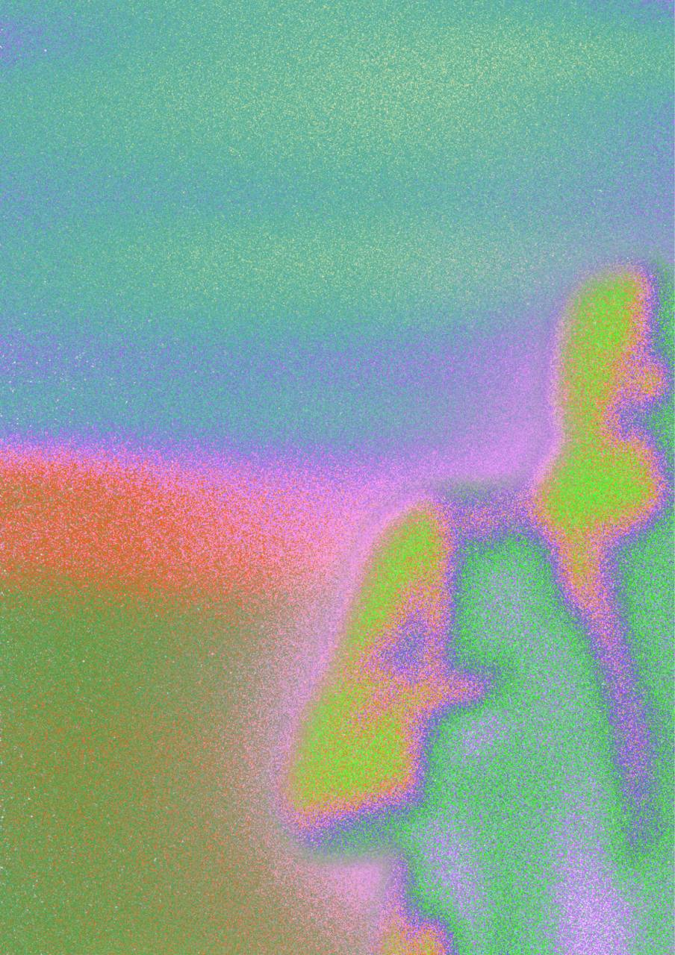




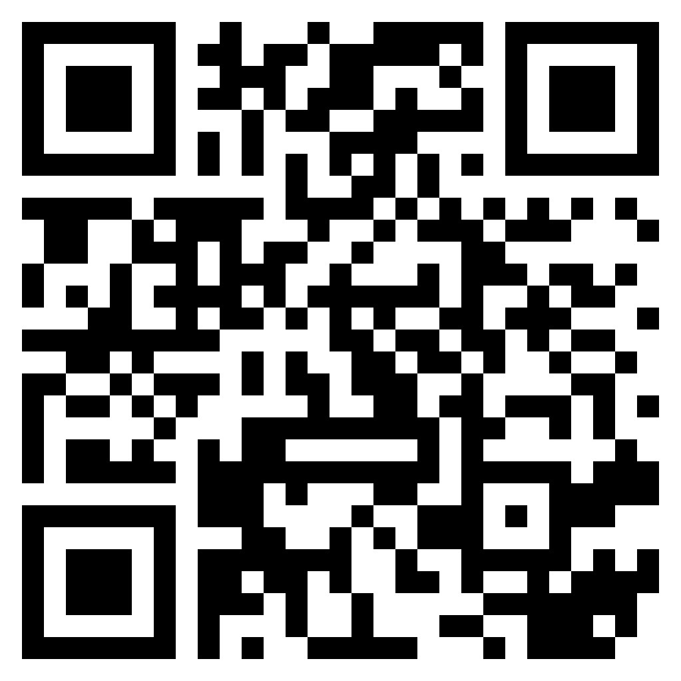
Song Queue Sign-Up Form
SINGUTD
Want to showcase your singing skills? Join the song queue here!!!

